Slide 1
ECE408 Fall 2015 Applied Parallel Programming Lecture 11 Parallel Computation Patterns – Reduction Trees

Slide 2
Objective
Introduce the concept of Reduction Trees, arguably the most widely used parallel computation pattern
Memory coalescing
Control divergence
Thread utilization

Slide 3
Scales of Parallelism
Instruction Level
Data Level
Task Level
Work Level

Slide 4
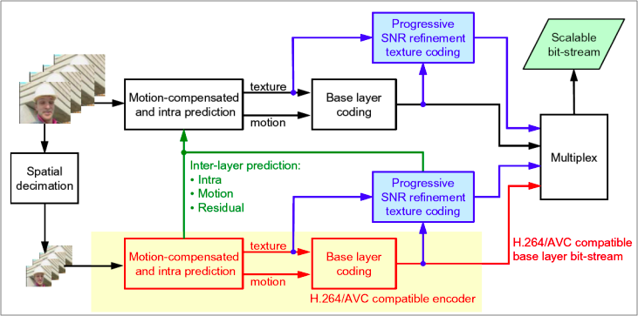
How would we parallelize this?
H.264 Video Encode

Slide 5
What is a reduction computation
Summarize a set of input values into one value using a “reduction operation”
Max
Min
Sum
Product
Often with user defined reduction operation function as long as the operation
Is associative and commutative
Has a well-defined identity value (e.g., 0 for sum)

Slide 6
Partition and Summarize
A commonly used strategy for processing large input data sets
There is no required order of processing elements in a data set (associative and commutative)
Partition the data set into smaller chunks
Have each thread to process a chunk
Use a reduction tree to summarize the results from each chunk into the final answer
We will focus on the reduction tree step for now.
Google MapReduce and Hadoop frameworks are examples of this pattern

Slide 7
A sequential reduction algorithm performs O(N) operations
Initialize the result as an identity value for the reduction operation
Smallest possible value for max reduction
Largest possible value for min reduction
0 for sum reduction
1 for product reduction
Scan through the input and perform the reduction operation between the result value and the current input value

Slide 8
A parallel reduction tree algorithm performs N-1 Operations in log(N) steps
3
1
7
0
4
1
6
3
max
max
max
max
3
7
4
6
max
max
7
6
max
7

Slide 9
A Quick Analysis
For N input values, the reduction tree performs
(1/2)N + (1/4)N + (1/8)N + … (1/2^{logN})N) = N-1 operations
In Log (N) steps – 1,000,000 input values take 20 steps
Assuming that we have enough execution resources
Average Parallelism (N-1)/Log(N))
For N = 1,000,000, average parallelism is 50,000
However, peak resource requirement is 500,000!
This is a work-efficient parallel algorithm
The amount of work done is comparable to sequential
Many parallel algorithms are not work efficient

Slide 10
Simple Vector Reduction
Thread 0
Thread 1
Thread 2
Thread 3
Thread 4
Thread 5
0
1
2
3
4
5
6
7
8
9
10
11
1
0+1
2+3
4+5
6+7
8+9
10+11
2
0...3
4..7
8..11
3
0..7
8..15
steps
Partial Sum elements

Slide 11
A Sum Example
Thread 0
Thread 1
Thread 2
Thread 3
3
1
7
0
4
1
6
3
1
4
7
5
9
Active Partial Sum elements
2
11
14
3
25
steps

Slide 12
Simple Thread Index to Data Mapping
Each thread is responsible of an even-index location of the partial sum vector
One input is the location of responsibility
After each step, half of the threads are no longer needed
In each step, one of the inputs comes from an increasing distance away

Slide 13
A Simple Thread Block Design
Each thread block takes 2* BlockDim input elements
Each thread loads 2 elements into shared memory
__shared__ float partialSum[2 * BLOCK_SIZE];
unsigned int tx = threadIdx.x;
unsigned int start = 2 * blockIdx.x * blockDim.x;
partialSum[t] = input[start + tx];
partialSum[blockDim + tx] = input[start + blockDim.x + tx];

Slide 14
The Reduction Step
unsigned int stride;
for (stride = 1; stride <= blockDim.x; stride *= 2) {
__syncthreads();
if (tx % stride == 0)
partialSum[2 * tx] += partialSum[2 * tx + stride];
}
Let’s think about __syncthreads placement?

Slide 15
Any More QUESTIONS?

